Slide 1
Verified Caller API Proposal
China Telecom, ZTE
Contacts: xudan6@chinatelecom.cn, Tu.JiaSun@zte.com.cn

Slide 2
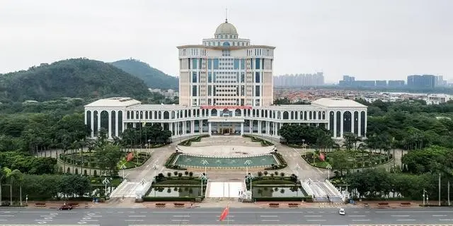
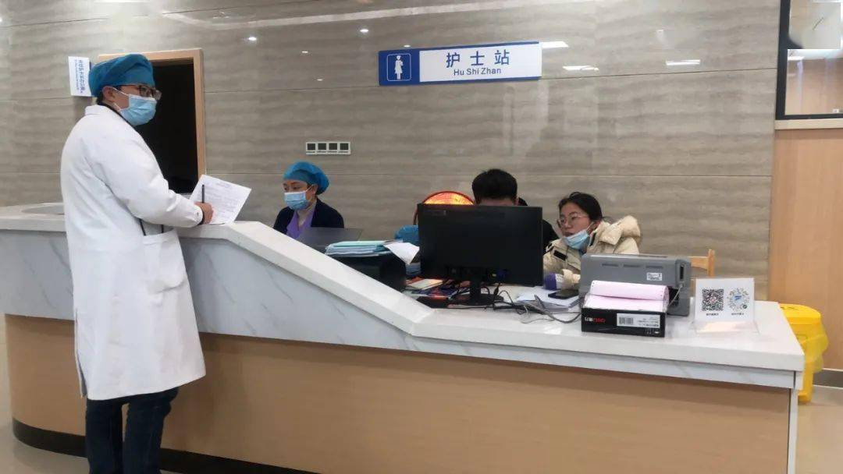

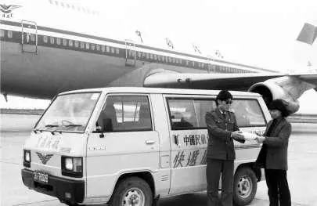
Verified Caller Use Cases
Due to the prevalence of online fraud and cybercrime as significant challenges in e-commerce, GSMA, mobile operators, and technical partners are prioritizing the GSMA Open Gateway initiative to address online crime. Verified Caller authenticated by operators, delivers caller business cards, significantly reducing the likelihood of fraud calls while ensuring legitimate calls are easily received by consumers.
Mature Fields
New Potential Valued Fields
Government and public service
Hospitals
Insurance/Bank
Express delivery,
Criminals often exploit the identity of public service departments to carry out scams, leading to a lack of trust in legitimate calls from these entities by the general public. This skepticism results in the rejection of unfamiliar numbers, adversely affecting the department's operations and highlighting the urgent need for improvement.
Proactively inform customers of the identity and purpose for their phone calls, improve the efficiency of phone calls, promote the company's brand, and avoid being rejected as unfamiliar harassing calls, resulting in low work efficiency.

Slide 3
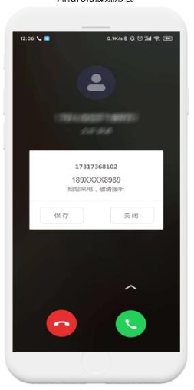
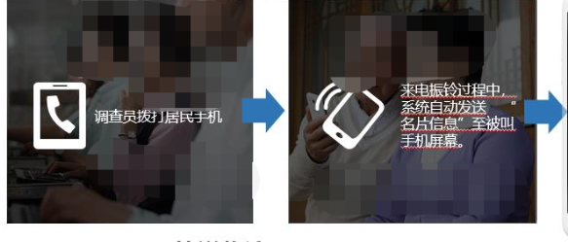
How can users get the services
Step 1: Service Registration
Purpose: Applicants for business services need to authenticate their identity to the operator and associate themselves with specific caller numbers.
Operators provide a self-registration platform on websites, or telecom service center for enterprise and organizations to apply for the services. Applicants submit their identification documents (such as business licenses, tax IDs) along with the associated caller numbers.
Typically, operators require offline verification and subsequently notify applicants of the verification outcome.
For certain businesses that require dynamic management of content and numbers, after successful verification, users receive self-maintained website addresses and usernames from the business platform. Users can then log in to the platform to independently edit content and policies.
Step2: Service Trigger
The verified caller dials the called's phone.And the enterprise triggers the sending of text or multimedia calling business cards through the API.
The “business card”information is sent to the screen of the called’s mobile phone by USSD，SMS or RCS.

Slide 4
Two service scenarios of Verified Caller for operators
Mature
Charging by month
Including X business card messages per month,
the service will be opened immediately, effective immediately, and
fees will be deducted immediately.
Path 1:
By default, the service is triggered for all calling.
Verified Caller
Monetization
Charging by API call times
Path 2:
The call and service triggers separately.
After the enterprise is registered and verified successfully,Each service needs to be triggered separately through the API. The operator charges the enterprise in accordance with the number of times that the service is invoked successfully.
Provisioning
Monitoring
Management

Slide 5
The implement proposal
Enterprises
Service registration application
Verified Caller API
（TargetNumber、SendNumber、Callbackurl、template code 、templateParams）
Notify the user and refuse the request
Notify the user that the request is successful.
Service API
Service registration
portal
Authentication and Security Check
Network Platform
（Open Gateway）
Registration and user information template
API(TargetNumber、SendNumber、Callbackurl、template code 、templateParams…)
Network API
N
Verified Caller platfom
Y
Registration
or not
Post
Network
Resource
USSD
SMS
RCS

Slide 6
The API definition proposal
API Name | Verfied caller API
Description | This API allows accurate operator certified "business card" information including SMS and video clip to be displayed on the phone screen of the called user before answering the call. This API will allow enterprise customers to vividly display their multimedia business cards and reduce the difficulty of malicious calls.
Input Parameters | TargetNumber(string)：called phone number
 | SendNumber(string)：caller phone number
 | Callbackurl(string)：Accept receipt address(string)
 | templatecode(long)：Template ID
 | templateParams(string):Template Params
Return Results | messages(string):OK means the request is normal,others is unnormal data(string):Information JSON string

Slide 7
Network Capability Requirements
TS 23.040 Short Message Service (SMS)
TS 23.228 IP Multimedia Subsystem (IMS) Stage 2
TS 23.090 Unstructured Supplementary Service Data (USSD); Stage 2
TS24.390 Unstructured Supplementary Service Data (USSD) using IP Multimedia (IM) Core Network (CN) subsystem IMS; Stage 3
TS 24.229 IP Multimedia Call Control Protocol based on Session Initiation Protocol (SIP) and Session Description Protocol (SDP);Stage 3
TS 23.218 IP Multimedia (IM) session handling; IM call model; Stage 2
GSM Association Official Document RCC.07 - Rich Communication Suite - Advanced Communications Services and Client Specification

Slide 8
Thank you

